Slide 1
Forming
BUILD Community Development Corporation
&
Housing First Erie
Tuesday, august 20

Slide 2
Our “Why”
24
YR
GAP
IN LIFE EXPECTANCY
62.3 years
86.3 years
Resides in underserved areas of Erie County
Resides in more affluent areas
of Erie County
An entire generation.

Slide 3
Social Drivers of Health

Slide 4
BUILD Focus Areas
TRUSTED ACCESS TO HEALTH CARE
SAFE & AFFORDABLE HOUSING
CAREER & WORKFORCE DEVELOPMENT
THRIVING NEIGHBORHOODS

Slide 5
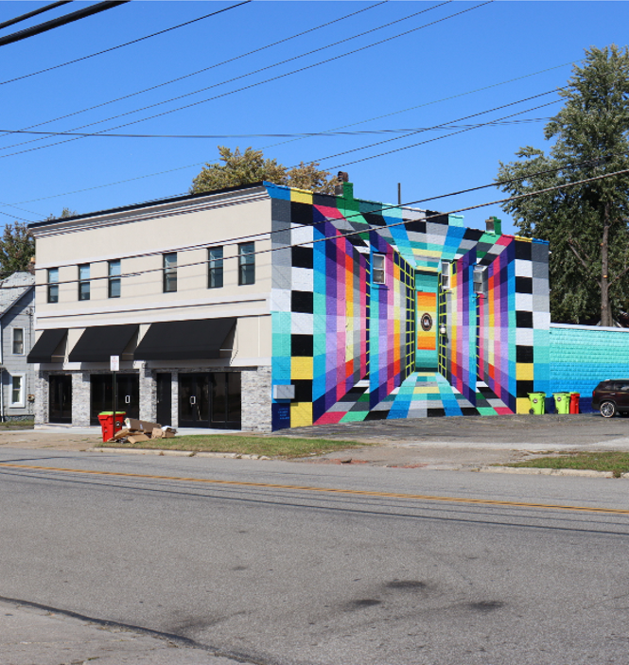
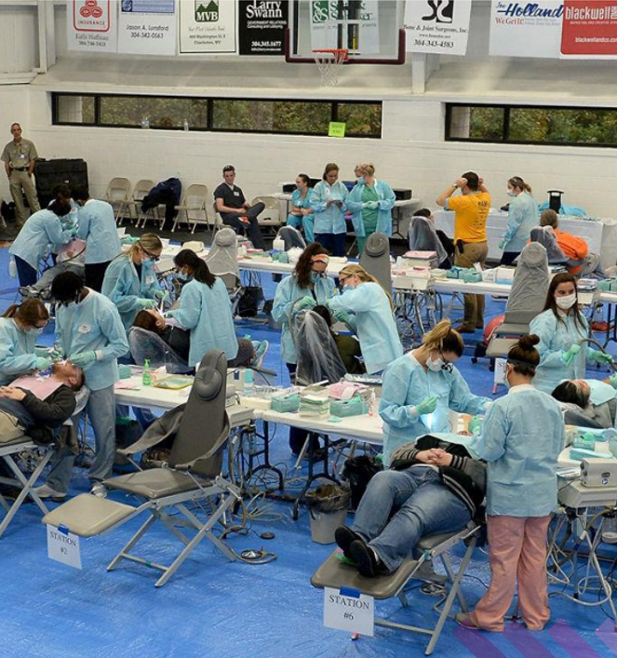
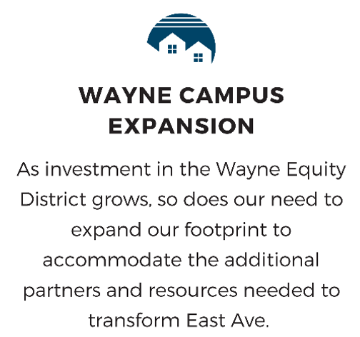
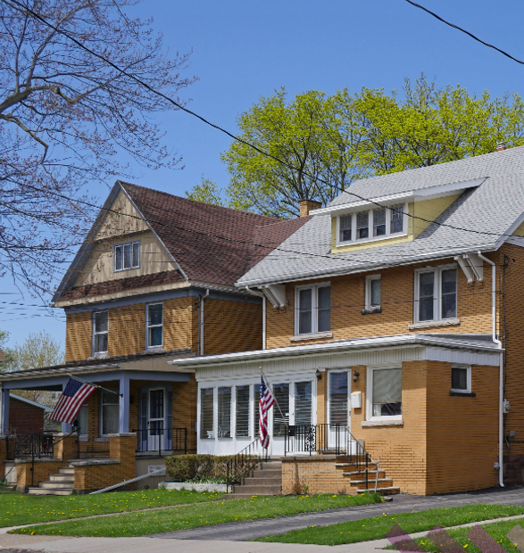
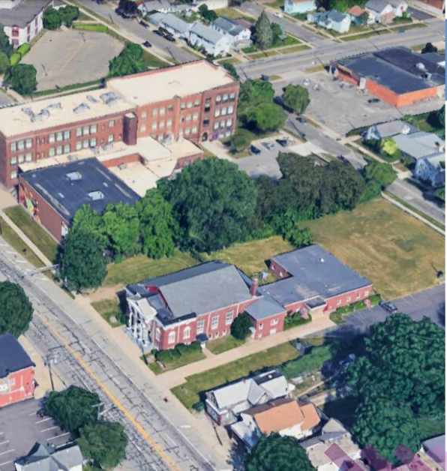
Phase 1 Projects

Slide 7
Housing first erie
Addressing chronic homelessness in erie county

Slide 8
Housing First Erie: Project Team
Erie Home Team
Gannon University
Hamot Health Foundation
Housing First Erie Project Team
Highmark/Allegheny Health Network
City of Erie
Mercyhurst University
HANDS
Housing Authority of the City of Erie
Erie County
Erie County Department of Human Services
Erie Community Foundation
Erie County Care Management

Slide 9
Housing First Erie: In action

Slide 10
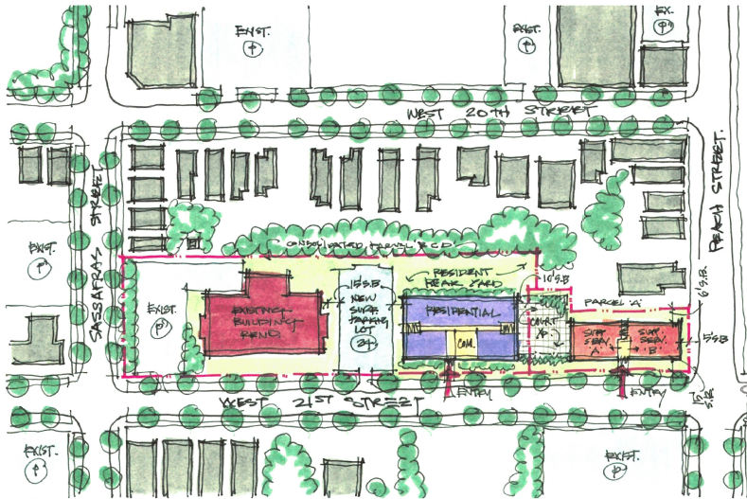
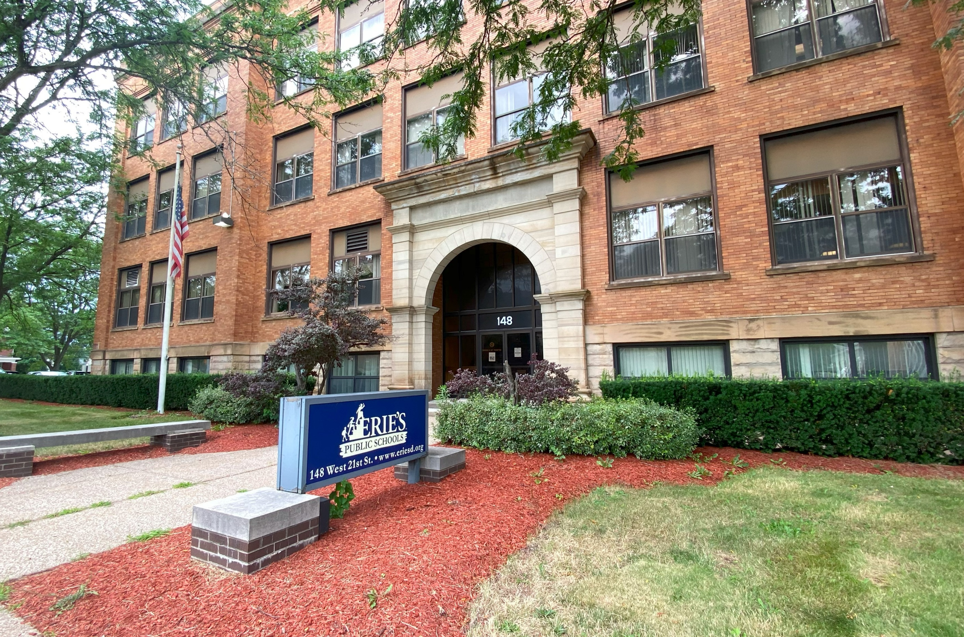
Demonstrating success
Supportive Housing Campus at an Erie School District Site
Rental Assistance: Project-based Housing Choice Vouchers from Housing Authority of City of Erie (RFP pending)
Supportive Services:
Integrated Care model between housing/behavioral health: A) Program Manager
B) Housing specialist
C) Case managers
D) Peer specialists
E) Contracted nurse/advanced practitioner
Facilities:
Building #1 (22 one-BR units of PSH)
$9 million Renovation, 12,000 sq. ft. for social service office space
Building #2 (50 one-BR units of PSH)
$18.8 million build (LIHTC round in Dec 2024), 3,500 sq. ft. for community & social service space

Slide 11
Total Funding Needs: 150 units
Low-Income Housing Tax Credits $14M
Debt & Soft Commitments $9.8M
Total Project Cost: $50,600,000
Gap Funding Needed: $20,000,000
Medicaid & Others $6.8M
Gap $10M
10 Years of Service Funding
Gap $4.8M
Gap $5.2M

Slide 12
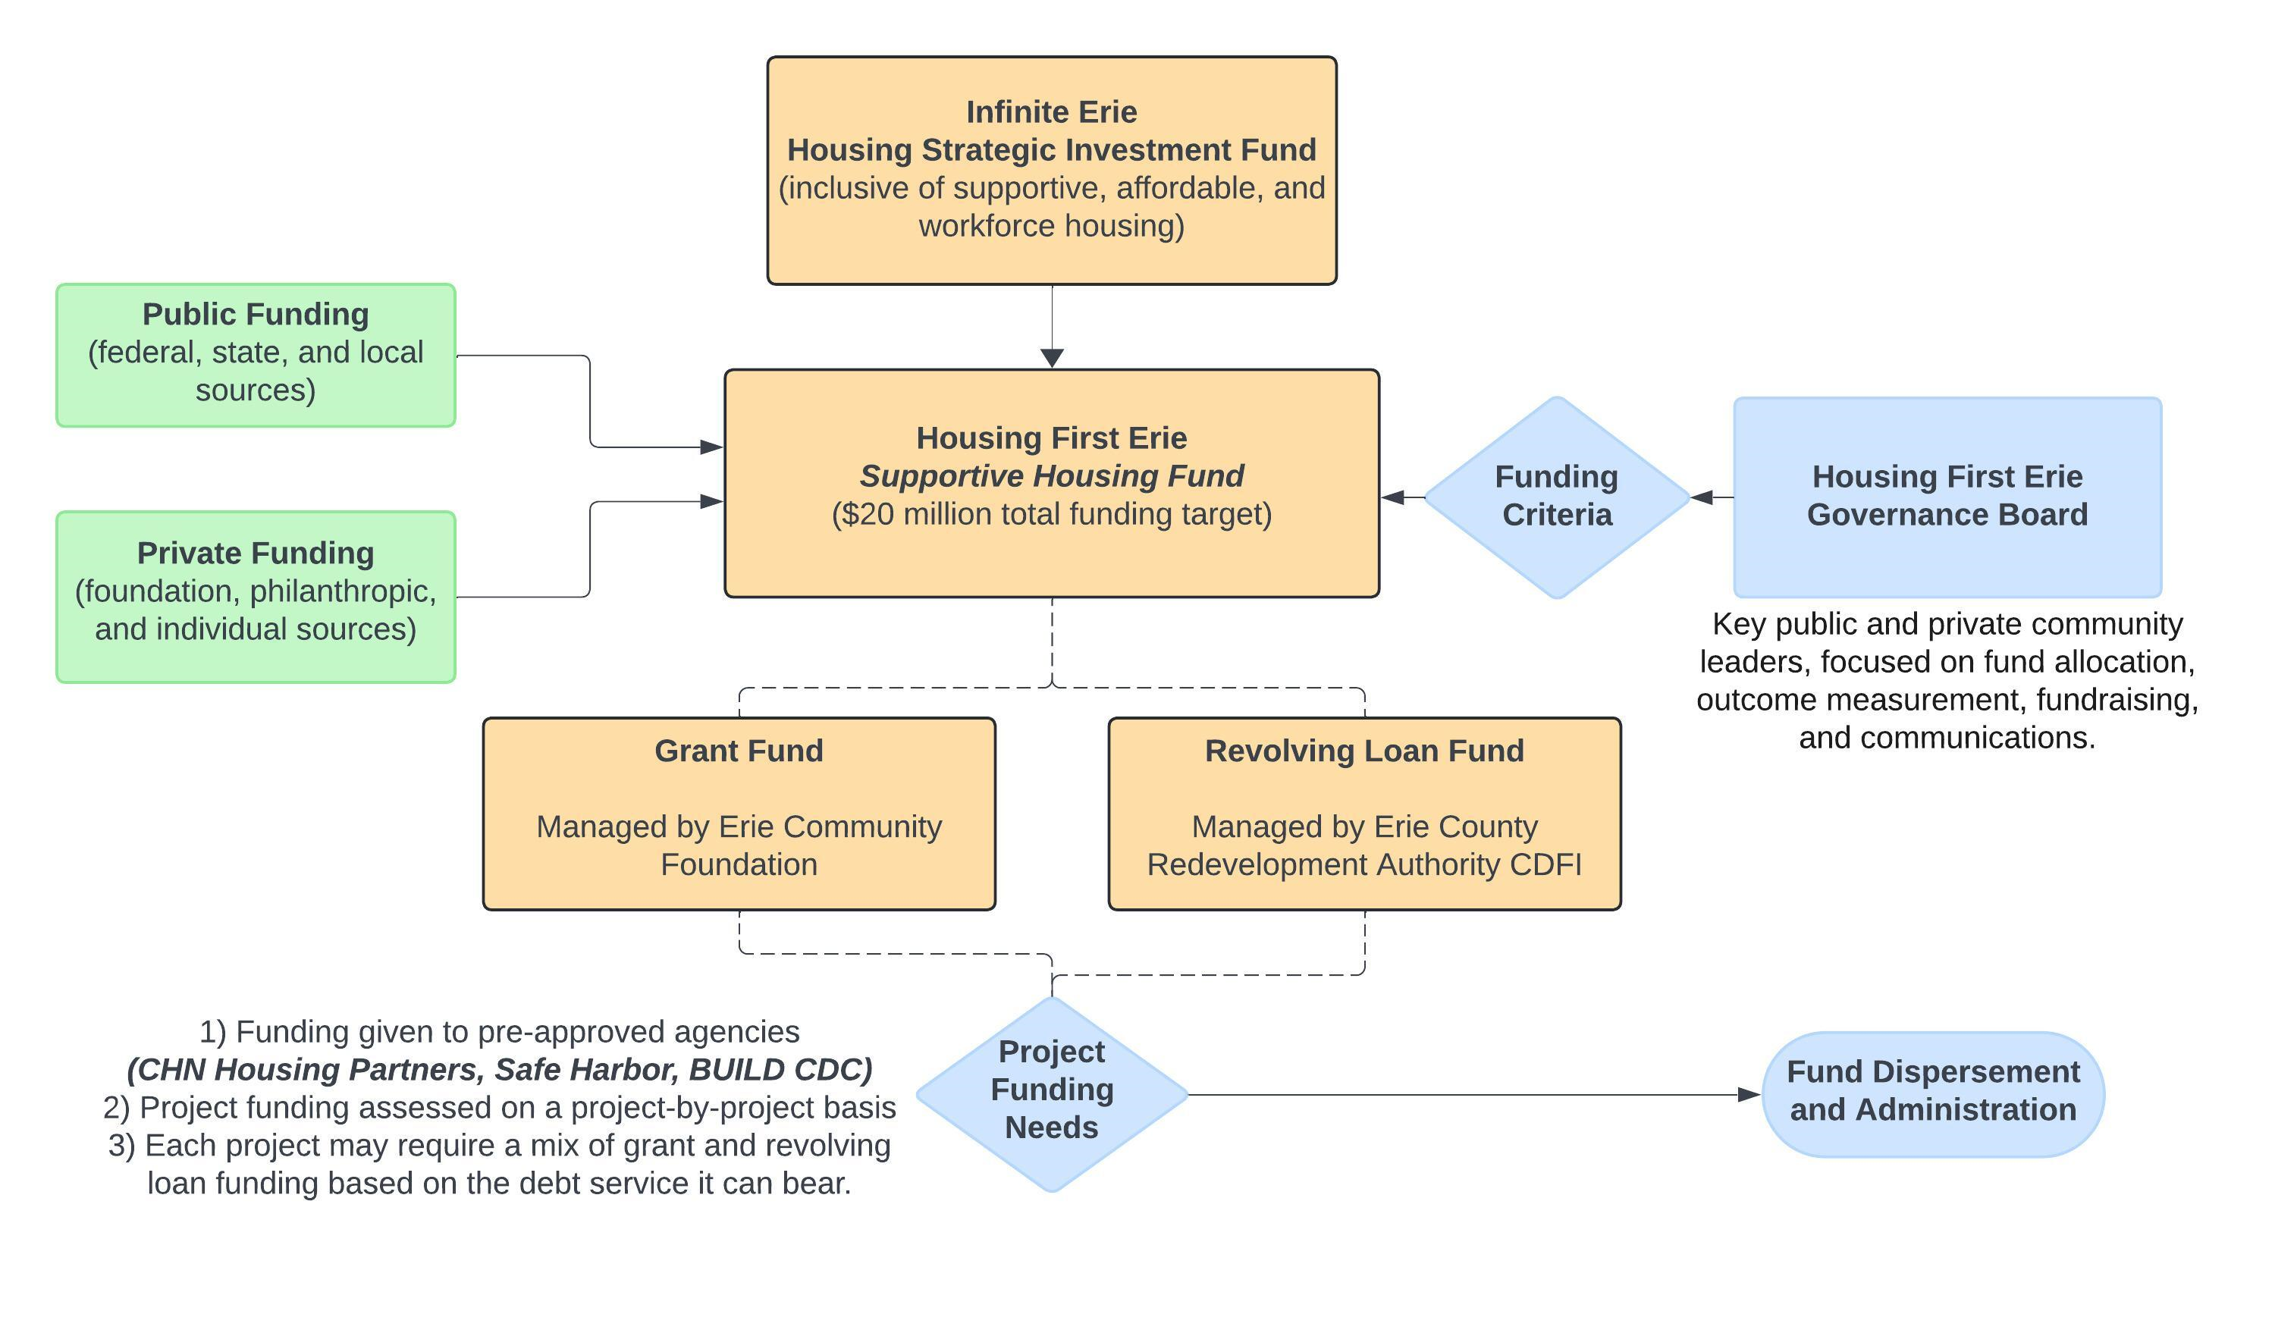
Infinite erie: Social impact fund

Slide 13
Exploring a Community development partnership for Montgomery county
Tuesday, august 20

Slide 14
Exploring a Community development partnership for montco
Our Process
Landscape Review Observe trends among marginalized communities in housing and health stability
Coalition-Building & Community Planning Form a “coalition of the willing” to define the focus:
Shared vision
Population
Action framework for housing, services, funding
Focused Pilot Launch a pilot to prove the model of care. Galvanize public support. Set up lead agencies & mutually reinforcing activities.
Bring to Scale Learn what you need to learn from the pilot. Bring the work to scale. Set up:
A) Governance structure
B) Backbone agency & Action leads
C) Sustainable funding
D) Clear outcomes measurement
E) Communications approach
Observe
Plan
Do
Study
Adjust
Our Partnership

Slide 15
Landscape review
Exploration Area: Observe trends among marginalized communities in housing and health stability
Guiding Questions: What community need do you observe? What are the key barriers to housing and health stability in MontCo?

Slide 16
Coalition-building & Community planning
Exploration Area: Form a “coalition of the willing” to define the focus: A) Shared vision; B) Population; C) Action framework for housing, services, funding
Guiding Questions: What partners are willing and effective in our coalition? What should be our focused priority; where should and can we demonstrate success?

Slide 17
Focused Pilot
Exploration Area: Launch a pilot to prove the model of care. Galvanize public support. Set up lead agencies & mutually reinforcing activities.
Guiding Questions: Who can lead our pilot? What do we need to launch our pilot (agencies, funding, policy, etc.)? What is the programmatic and partnership structure of our pilot?

Slide 18
Bring to scale
Exploration Area: Learn what you need to learn from the pilot. Bring the work to scale. Set up: A) Governance structure; B) Backbone agency & Action leads; C) Sustainable funding; D) Clear outcomes measurement; E) Communications approach
Guiding Questions: What did we learn from the pilot? What governance and action structure do we need in place to bring this work to scale? Who is our backbone support agency?

Slide 19
THANK YOU, MONTCO
STAY IN TOUCH
Daria Devlin
Director of Social Impact, Hamot Health Foundation
Executive Director, BUILD CDC
(814) 460-5387
devlinds@upmc.edu
Wyatt Schroeder
Executive Director, Hemlock & Forge
(484) 283-5860
wyatt@hemlockandforge.com
Supportive housing to end homelessness in PA & Delaware

